Slide 1
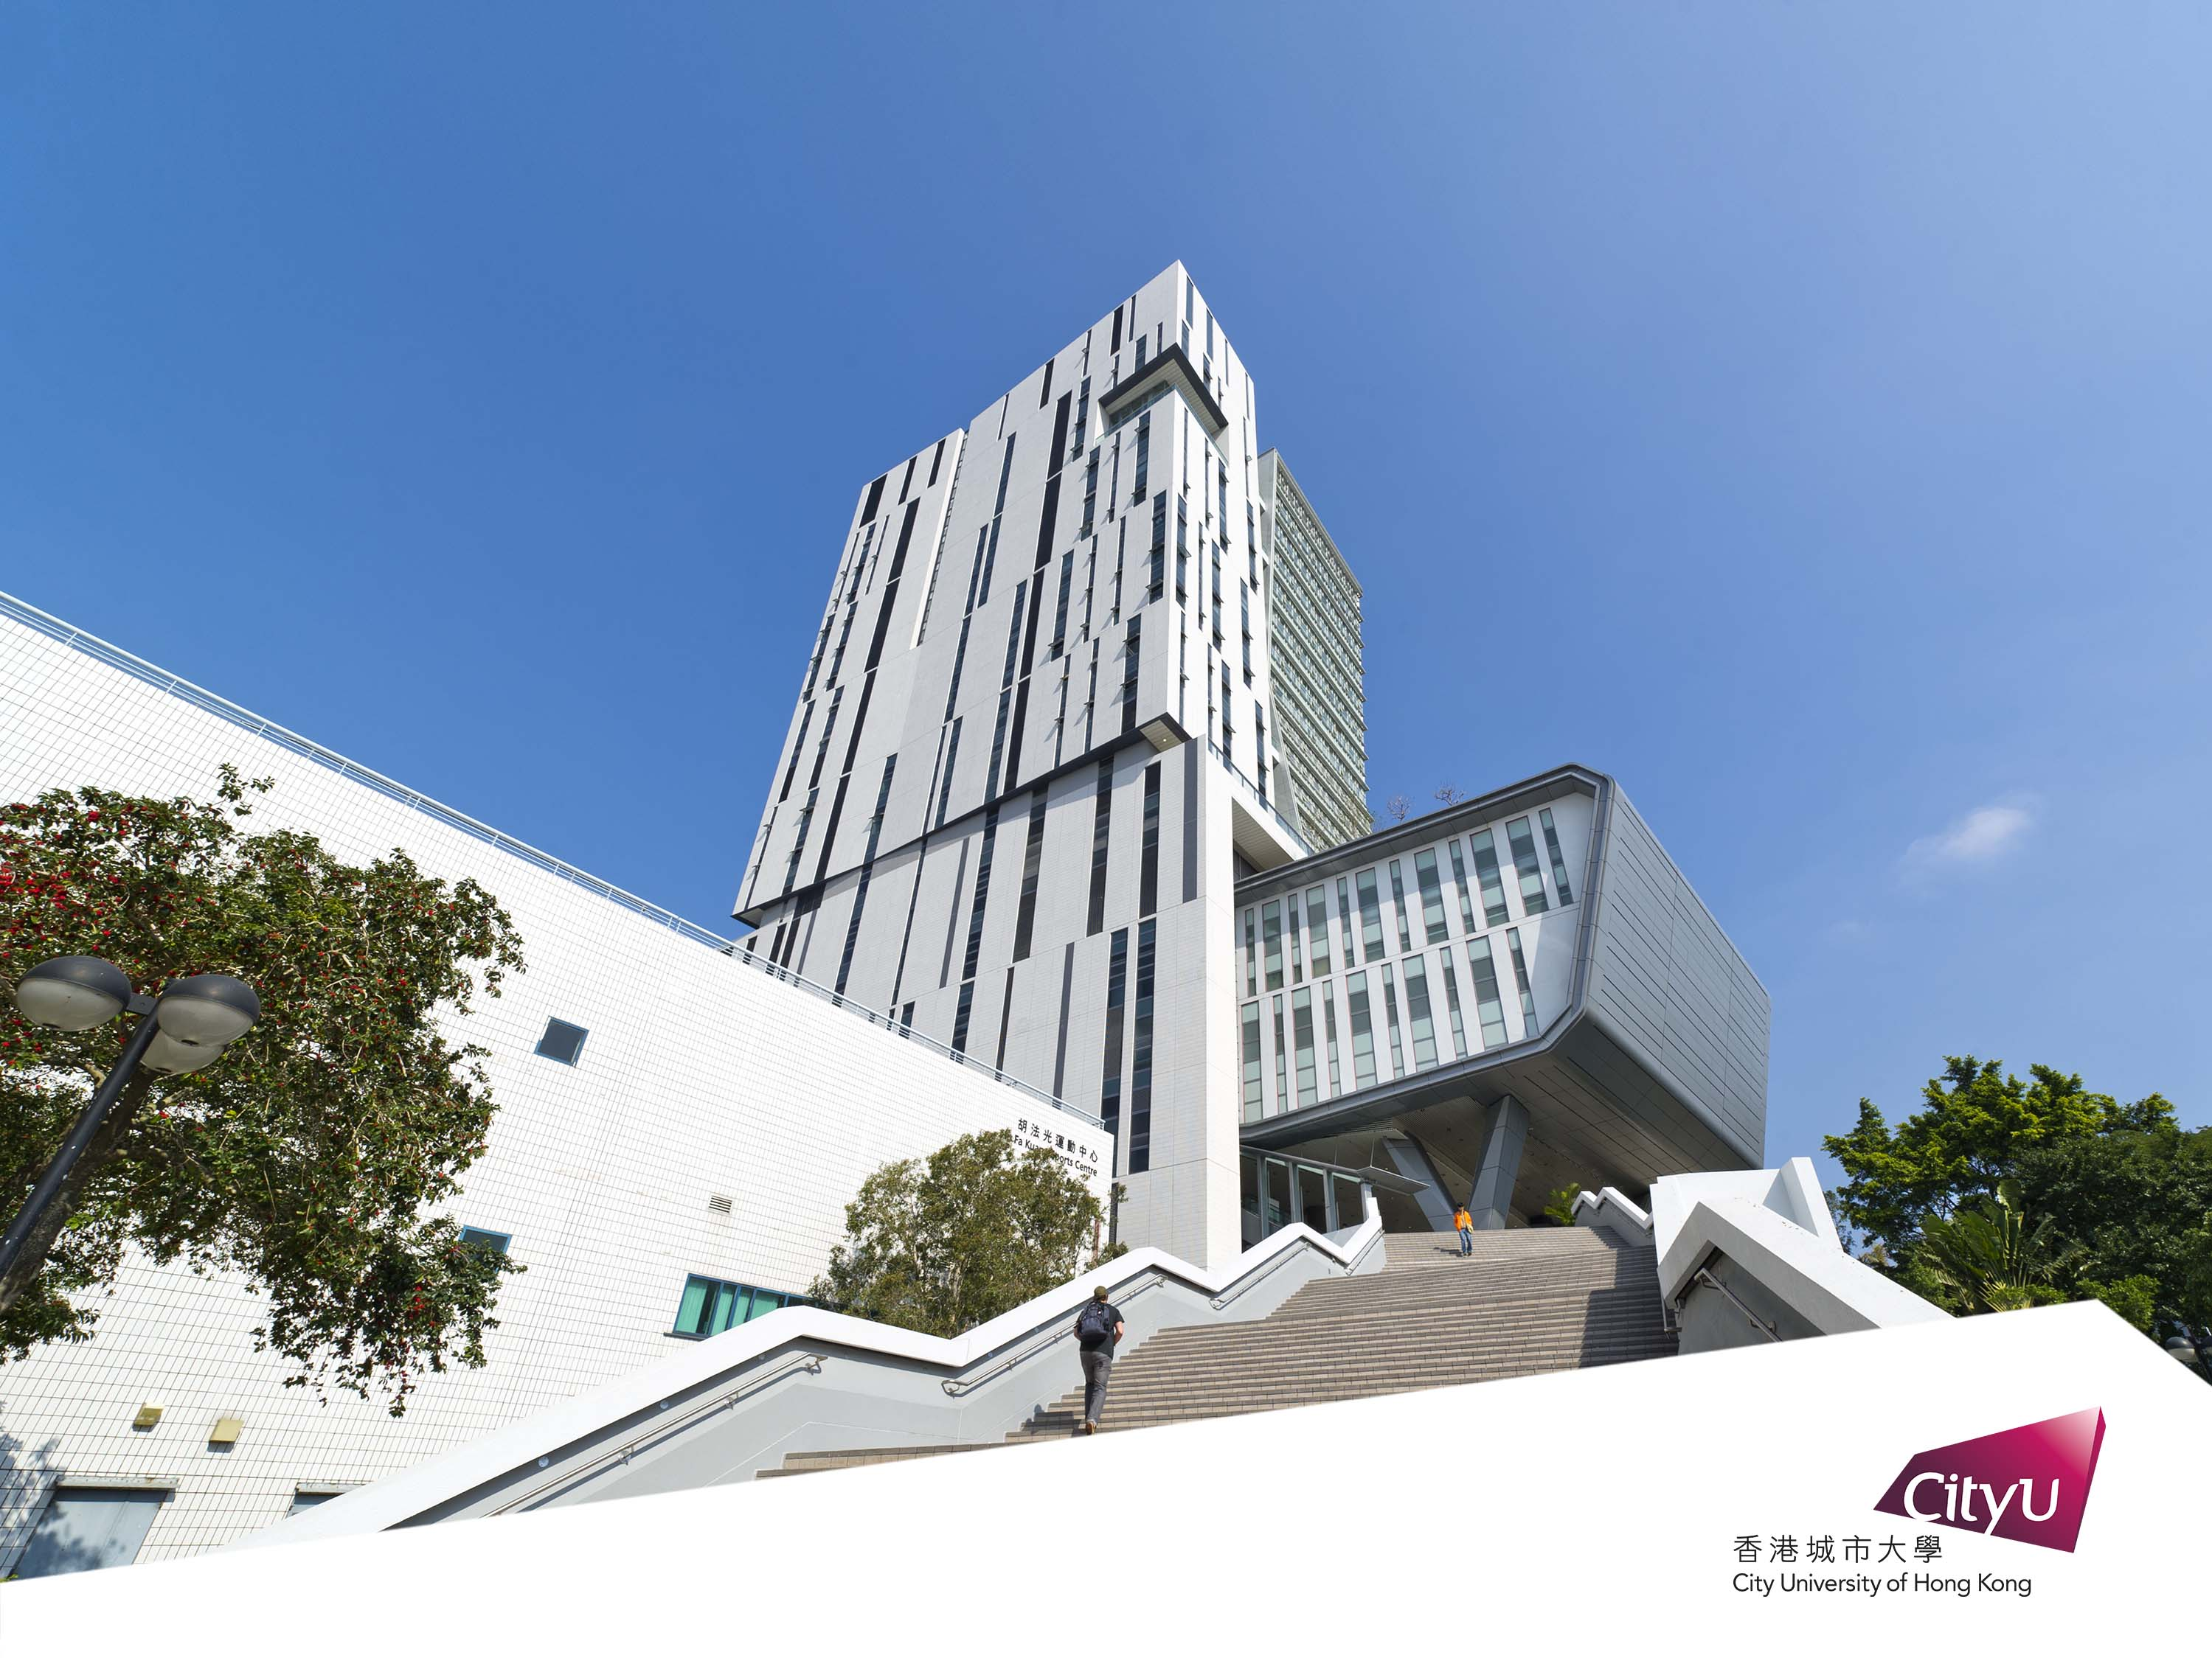

Deep Learning Workshop for Secondary School Students
By CityU EE Department

Slide 2

Building a Pokemon classifier with
TensorFlow, Keras and Colab

Slide 3





5 types of Pokemon to be classified
比卡超
Pikachu
小火龍
Charmander
車厘龜
Squirtle
奇異種子
Bulbasaur
超夢夢
Mewtwo

Slide 4

Which class does this image belong to?
Pikachu
Charmander
Squirtle
Bulbasaur
Mewtwo
Input image
Machine learning classifier

Slide 5
TensorFlow, Keras and Colab
TensorFlow
Open Source Machine Learning library
Keras
High Level API
Colaboratory(Colab)
Free Jupyter notebook environment with free GPU runtime
CPU: Bicycle
GPU: Car
TPU: Rocket

Slide 6
TensorFlow, Keras and Colab
Data collection
Defining your model
Model training
Model evaluation
Prediction
most of the work
few lines of code
one line
one line
one line

Slide 7
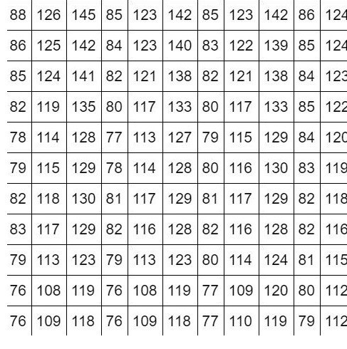
How do computers “see”?
What your computer see
What you see

Slide 8


Extracting features from images
We look for lines, edges and shapes to learn the concept of a dog
These are the features we want to extract
Lines, Edges, Shapes (features)
Image
Concept of a dog

Slide 9
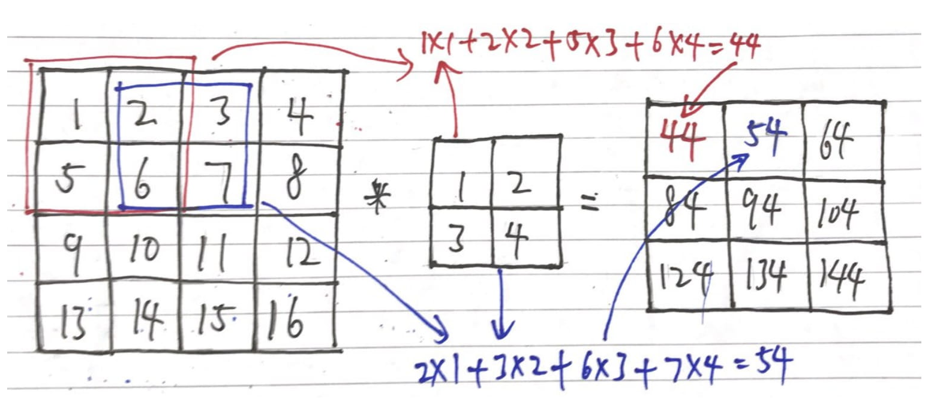
Convolution – detecting edges from images
The math operation “convolution” can be used to detect edges/extract features from an image
Image
Feature map
Filter/kernel

Slide 10
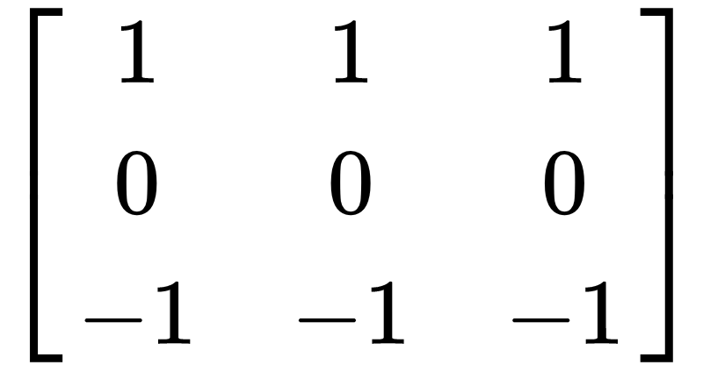
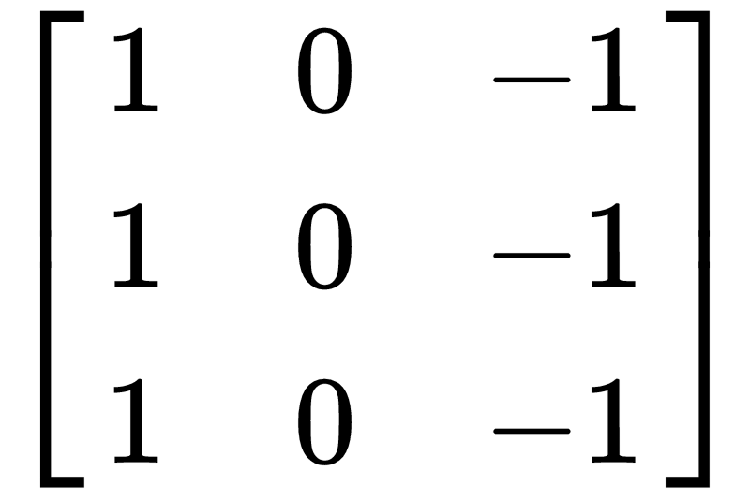
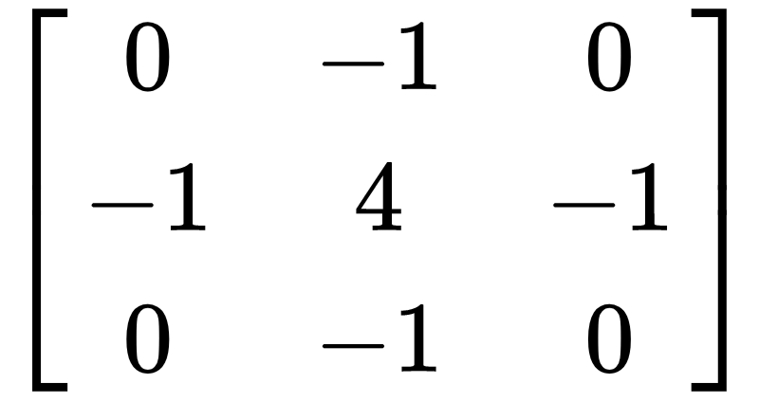
Convolution – detecting edges from images
These filters can be used to detect horizontal lines, vertical lines, and edges respectively
Horizontal line filter
Vertical line filter
Laplacian filter (edge detection)

Slide 11
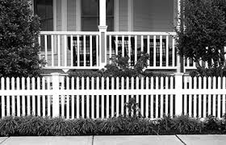
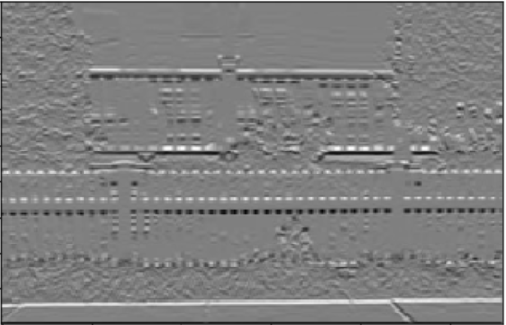
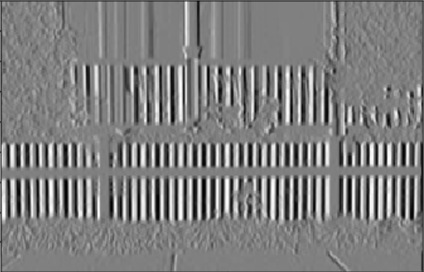
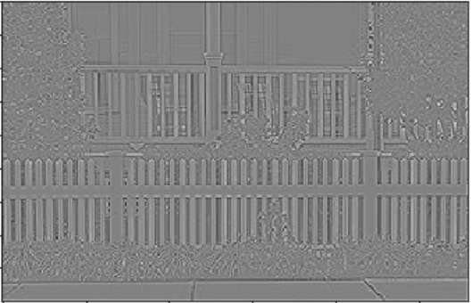
Convolution – detecting edges from images
An image after taking the convolution with…
Horizontal line filter
Laplacian filter (edge detection)
Vertical line filter

Slide 12
Now I have the features,
what’s next?

Slide 13

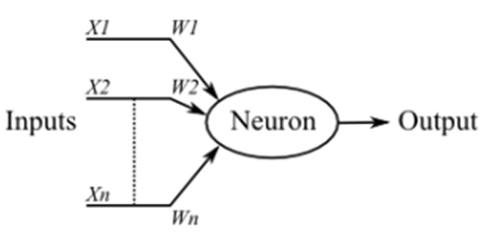
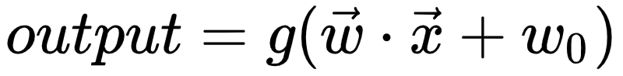
Modelling the brain – artificial neural network
A biological neuron

Slide 14
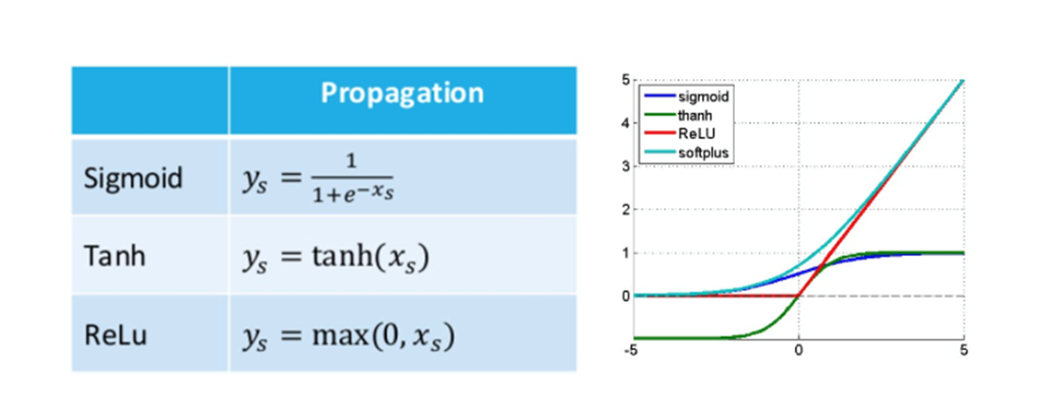
Activation Function ━ Adding Non-Linearity
Full list of common activation functions: https://keras.io/activations/

Slide 15
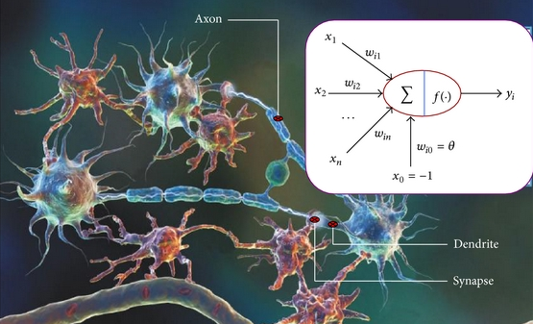
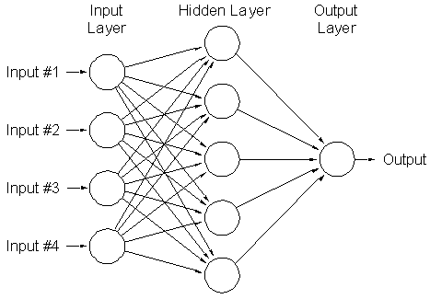
Modelling the brain – artificial neural network
Putting many neurons together, we have an artificial neural network
Aka: deep neural network, fully connected neural network, connectionist system, multilayer perceptron etc

Slide 16
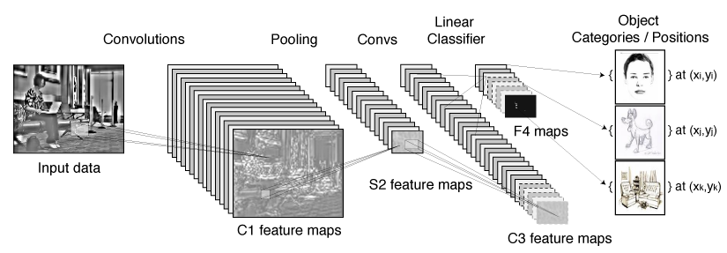
Learning the filters by convolutional neural network
Instead of handcrafting the filters, they can be learned by the convolutional neural network
Fully connected layer
Class probability
90%
5%
Feature map
5%
Feature map
Feature map

Slide 17
Hands-on coding!

Slide 18
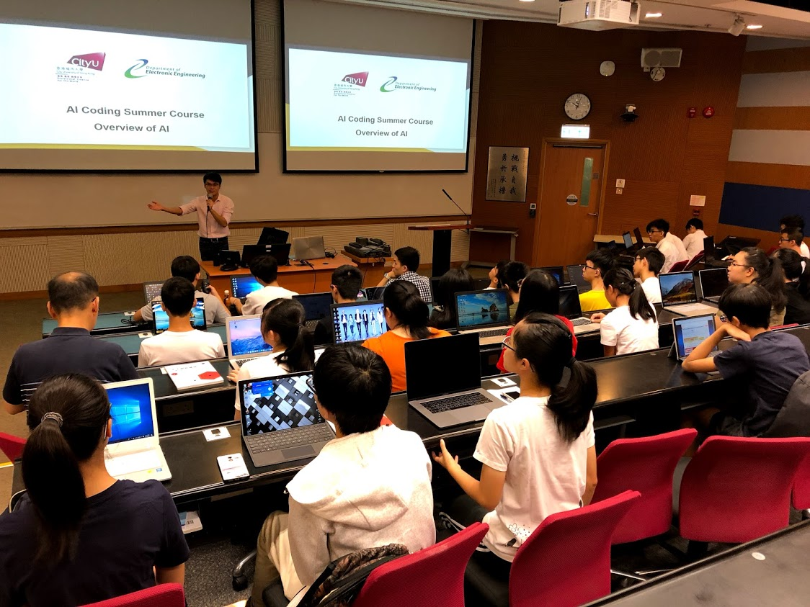
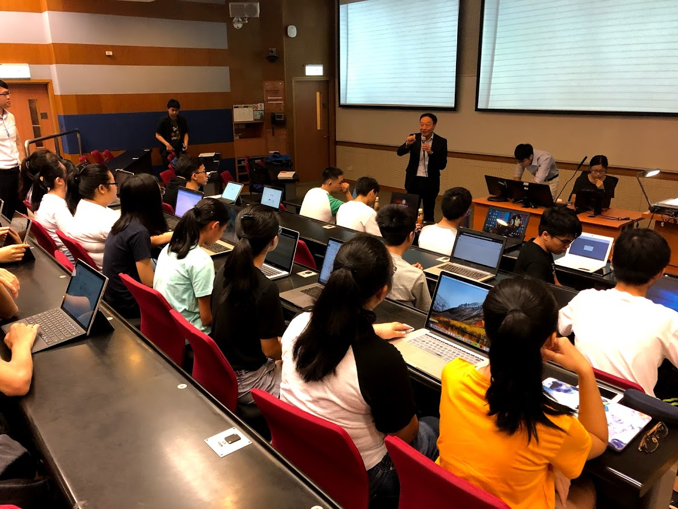
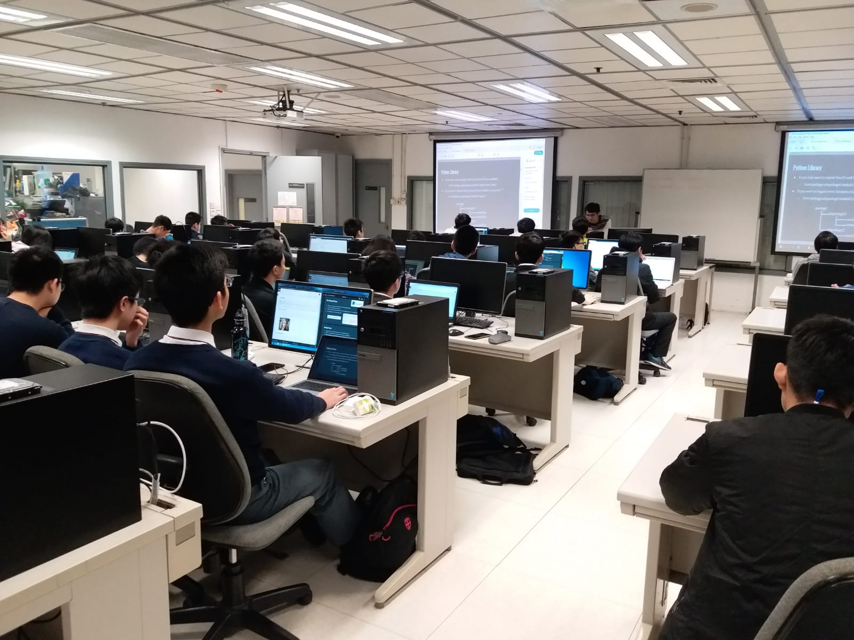
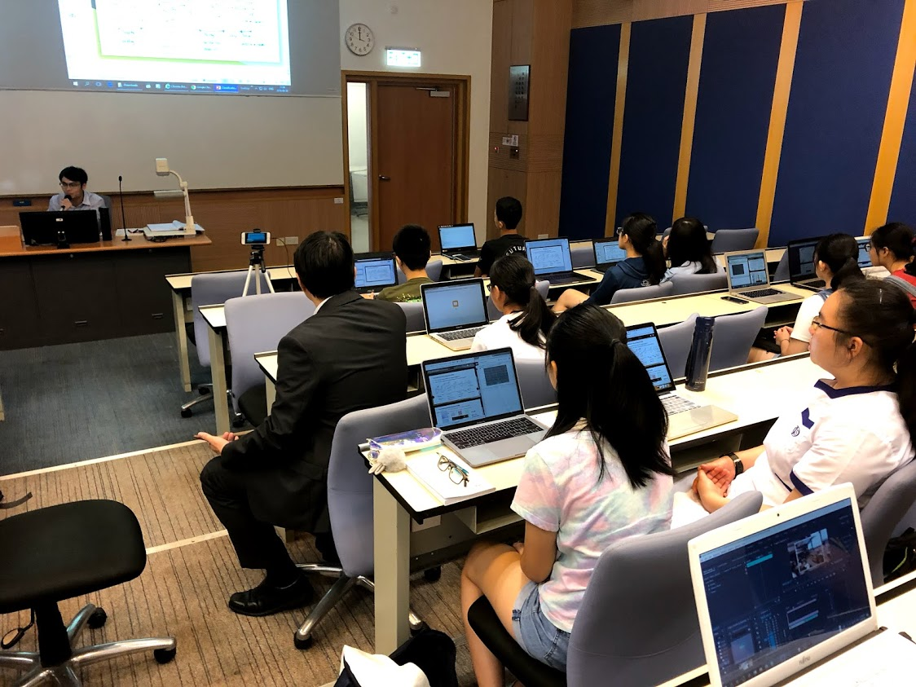
Past workshops

Slide 19
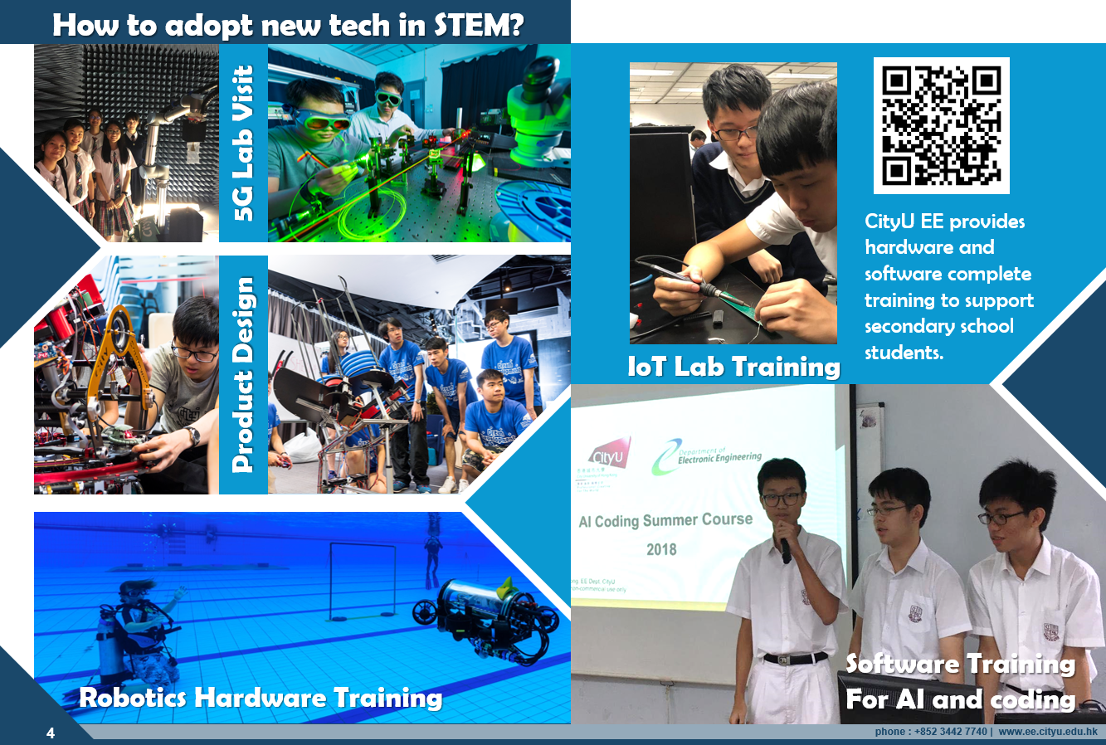

Slide 20
Acknowledgements
Prof. Stella Pang – Head, Department of EE
Kinni Mew – CityU EE Alumni, GDG Developer
John Wong – Research Assistant, Department of EE
Credit to PyImageSearch for the dataset

Slide 21


